Slide 1




Инструменти за разработка
Разработка на софтуер
Учителски екип
Обучение за ИТ кариера
https://it-kariera.mon.bg/e-learning/

Slide 2

Съдържание
Среди за разработка (IDE)
допълнителни разширения
клавишни комбинации
Редактори
Командни инструменти
Търсене и промяна на кода

Slide 3








Integrated Development Environments (IDEs)
Visual Studio, IntelliJ IDEA, Eclipse, Netbeans, JDeveloper, WebStorm, Code::Blocks

Slide 4
Visual Studio
Visual Studio is official .NET development tool from Microsoft
Multiple languages: C#, VB.NET, C++, JavaScript, …
Multiple technologies and platforms: ASP.NET, WPF, Silverlight, WWF, WCF, Windows Phone
Very powerful and feature rich
Write, compile, model, design GUI, forms, data, build, execute, debug, test, deploy, refactor, …
Commercial product, has free editions

Slide 5
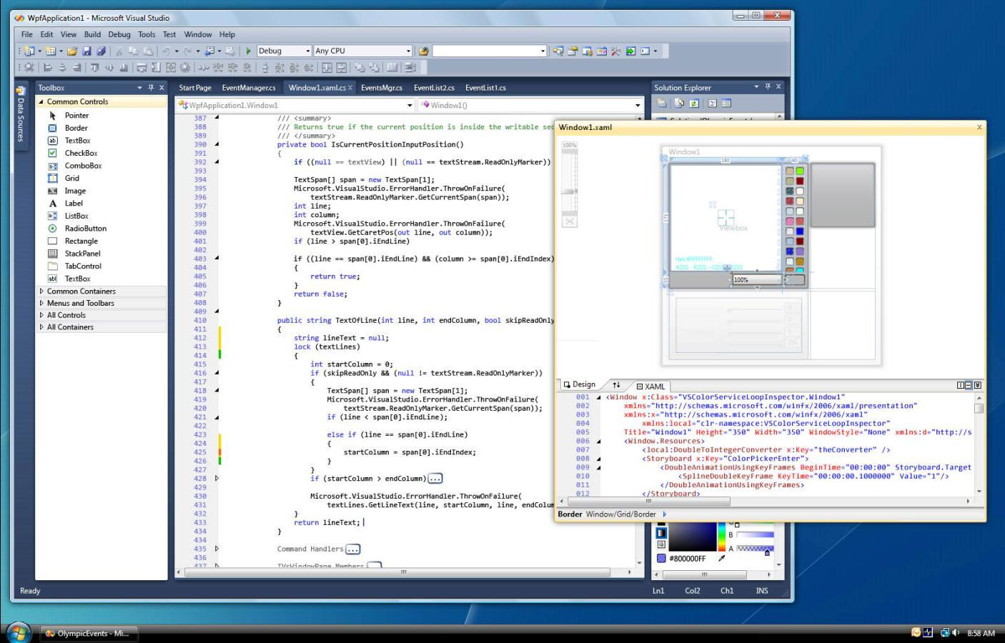
Visual Studio – Screenshot

Slide 6
Eclipse
Eclipse is the most popular Java IDE
Supports multiple languages and platforms: Java, Java EE, C++, PHP, Python, Ruby, mobile development, embedded development
Very powerful and feature rich
Write, compile, build, execute, debug, test, deploy, refactor, …
Thousands of plug-ins
Free, open-source product, very big community

Slide 7


Other IDEs
Other Java IDEs
Netbeans
Supports latest Java technologies
Nice GUI designer for Swing and JSF
IntelliJ IDEA – very powerful refactoring
JDeveloper – feature rich, supports UML
C++ IDEs
Code::Blocks
Bloodshed Dev-C++
JavaScript IDEs
Webstorm
Sublime Text

Slide 8

Обобщение
Exceptions provide a flexible error handling mechanism
Allow errors to be handled at multiple levels
Each exception handler processes only errors of a particular type (and its child types)
Other types of errors are processed by some other handlers later
Unhandled exceptions cause error messages
Try-finally ensures given code block is always executed (even when an exception is thrown)

Slide 9
Инструменти за разработка
https://it-kariera.mon.bg/e-learning/

Slide 10

Лиценз
Настоящият курс (слайдове, примери, видео, задачи и др.) се разпространяват под свободен лиценз "Creative Commons Attribution-NonCommercial-ShareAlike 4.0 International"
Благодарности: настоящият материал може да съдържа части от следните източници
Книга "Основи на програмирането със C#" от Светлин Наков и колектив с лиценз CC-BY-SA

